Slide 1
Johns Hopkins University Data Science Capstone Project
Project: Next Word Predictor
By: Seah Kai Jun Joel

Slide 2
Project purpose
To predict next words using a project to complete the sentence. Predicted output words can be used to help the reader guess the possible words that will be used to complete a sentence based on the output if the reader has no clue on what to fill in

Slide 3
Features
It tells you what are the possible words that can come up once you type a sentence
Shiny package
User Interface

Slide 4
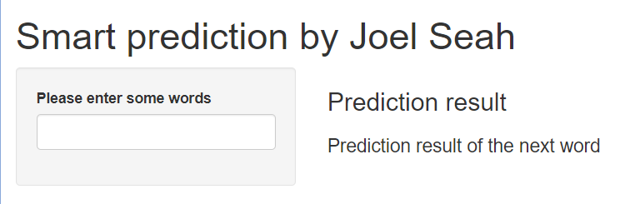
Explaining how it works
If you type I am in this box,
And words like happy, sad appear
It means the model predicts that the possible next words are happy and sad
If you type a word here it wil predict the next word

Slide 5
For more information, please go to the link below to see source code:
https://github.com/Wizardomahousukai/Capstone-project/blob/main/server.R
https://github.com/Wizardomahousukai/Capstone-project/blob/main/ui.R

